Slide 1


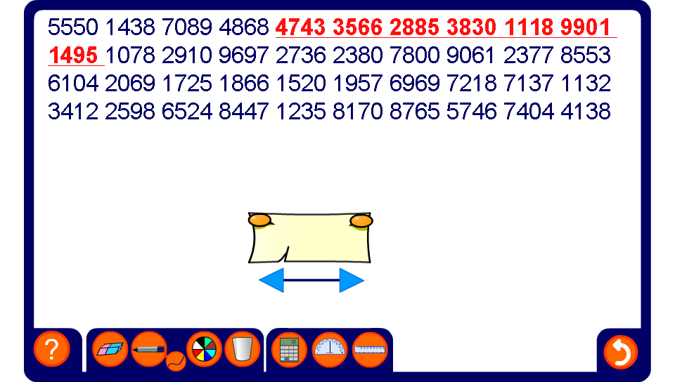


Moving averages
Notes:
Use this activity to demonstrate how to find the seven-point moving average for various sets of data.
Emphasise that the increase in the mean is much smaller than the jump from one number to the next in the raw data. In other words, the effect of an individual outlier is “smoothed out” in the means.

